Slide 1
CIS041-3 Advanced Information Technology
Artificial intelligence and Machine Learning
Gangmin Li
(Office hours: 13:00-17:00 every Friday)

Slide 2
Advanced Information Technology
Artificial Intelligence
Cloud Computing
Machine Learning
The Internet of Things
Virtual Reality

Slide 3
Outlines
AI in general
What is intelligence?
Why now? (3nd wave)
What is different this time? (NN and machine learning)
Artificial Neural Networks
What is ANN? (Biology – brain, Math – Function f, and computing – computing and memory)
ANN components
Active functions
ANN types
ANN applications (IT)

Slide 4
Introduction AI
What is AI?
Why The 3rd wave? - ML
What AI to do with Information Retrieval? - NLP

Slide 5
Artificial intelligence

Slide 6
The fourth industrial revolution
An era that will be defined and driven by extreme automation and ubiquitous connectivity.
Source: https://www.ubs.com/microsites/artificial-intelligence/en/new-dawn.html

Slide 7
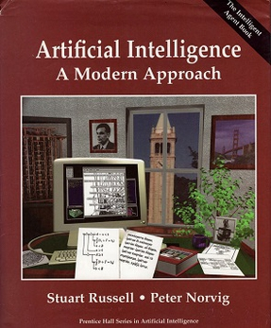
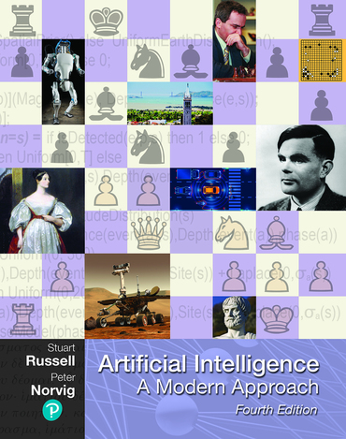
Artificial intelligence
Intelligence demonstrated by machines, as opposed to the natural intelligence displayed by animals and humans.
1st 1995
2020 4th edition

Slide 8
Artificial intelligence
System that:
Acting humanly
Thinking humanly
Thinking rationally
Acting rationally
Computational intelligence
Any system that perceives its environment and takes actions that maximize its chance of achieving its goals.
A man-made machine that has human intelligence

Slide 9
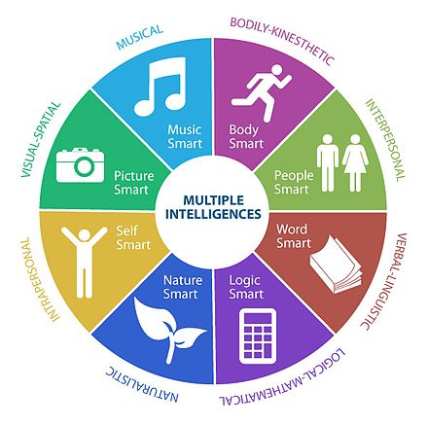
What is intelligence?
Controversial definitions. what its abilities are and whether or not it is quantifiable
Theory of multiple intelligences (MI): eight abilities
Musical-rhythmic and harmonic
Visual-spatial
Linguistic-verbal
Logical-mathematical
Bodily-kinesthetic
Interpersonal
Intrapersonal
Naturalistic

Slide 10
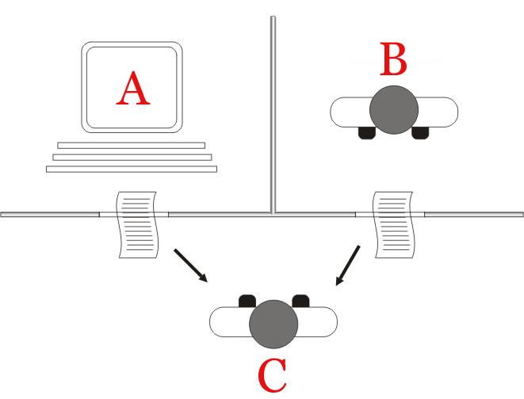
What is intelligence?
Unity of Intelligence. Think of intelligence as a comprehensive and single quality difference between human beings and non-human beings
Turing Test
The "standard interpretation" of the Turing test, in which player C, the interrogator, is given the task of trying to determine which player – A or B – is a computer and which is a human. The interrogator is limited to using the responses to written questions to make the determination.[1]

Slide 11
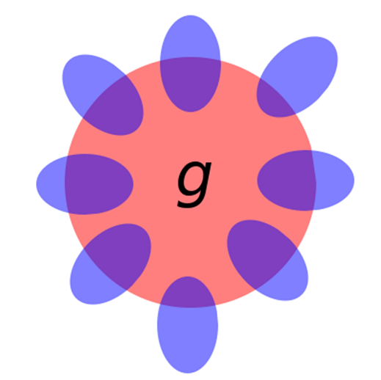
Theory of general intelligence: g factor
g factor is a construct developed in psychometric investigations of cognitive abilities and human intelligence.
It is a variable that summarizes positive correlations among different cognitive tasks, reflecting the fact that an individual's performance on one type of cognitive task tends to be comparable to that person's performance on other kinds of cognitive tasks.
It is measured by IQ (Intelligence quotient)

Slide 12
A brief history of AI

Slide 13
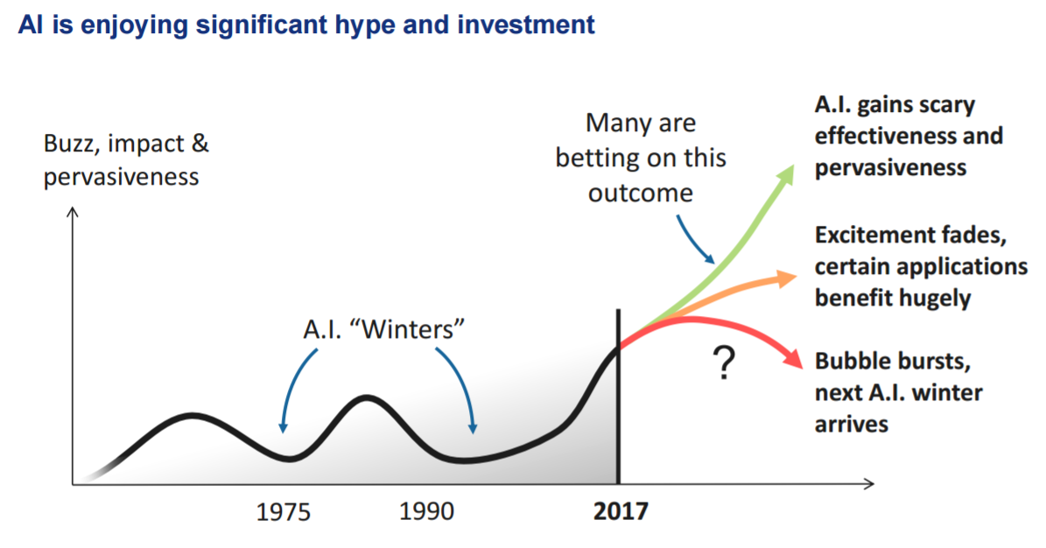
Is winter coming? The rise and fall of Artificial Intelligence

Slide 14
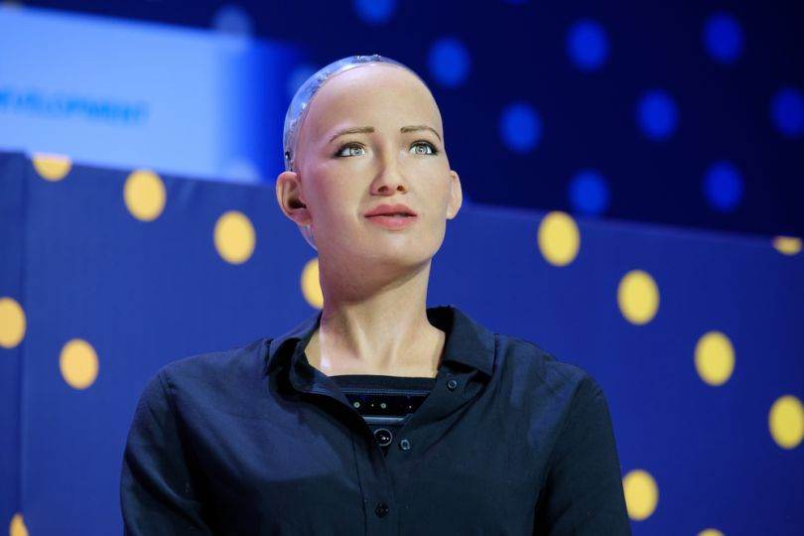
Current AI success
Manufacturing robots
Self-driving cars
Smart assistants
Healthcare management
Automated financial investing
Virtual travel booking agent
Social media monitoring
Marketing chatbots
Automatic access, process and make use of information!

Slide 15
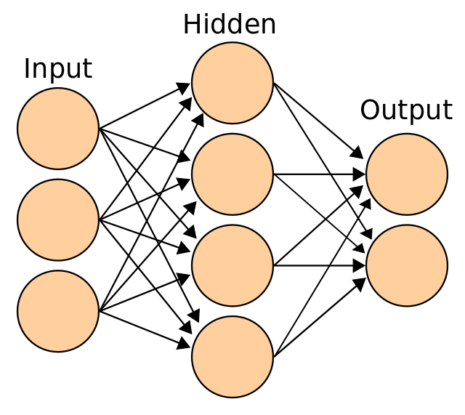
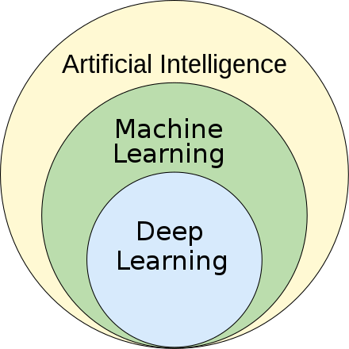
Two Key underlay technologies
Artificial Neural Networks (architecture)
Forward vs backward
Active function
Machine Learning (approach/framework)
backpropagation algorithm
Gradient descent

Slide 16
Neural Networks
Neural networks easy to understand
https://www.youtube.com/watch?v=CqOfi41LfDw
https://www.youtube.com/watch?v=aircAruvnKk&list=PLZHQObOWTQDNU6R1_67000Dx_ZCJB-3pi
The first attempt to build human brain, hope to achieve thinking …

Slide 17
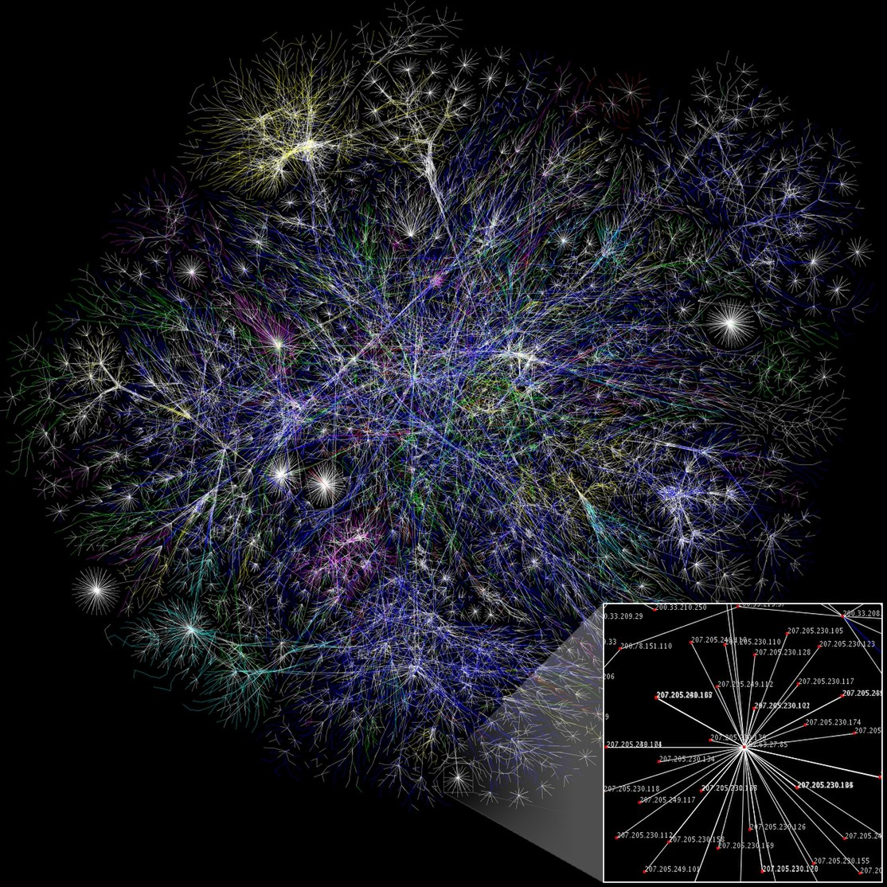
What is Artificial Neural Networks?
Artificial neural networks (ANNs), usually simply called neural networks (NNs) or neural nets, are computing systems inspired by the biological neural networks that constitute animal brains.
--wikiwand

Slide 18
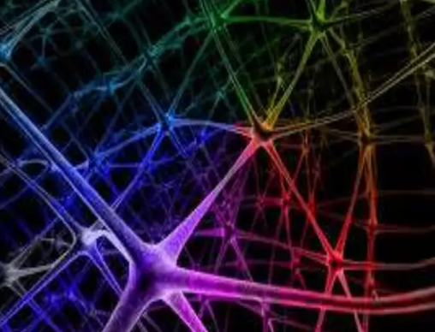
Three senses of Neural Networks
Biological: An computational information processing model that is inspired by the way of a biological nervous systems (like human brain) process information (human brain).
Math function: Neural network models can be viewed as defining a function that takes an input (observation) and produces an output (decision).

Slide 19
What is Artificial Neural Networks?
BLACK box: ANNs are considered nonliner statistical data processing modelling tools where the complex relationship between inputs and outputs are modelled or patterns are recorded (learnt).
Like CPU (now no one care about the logic circuit in side CPU) we only care about the ability of computing and memory.

Slide 20
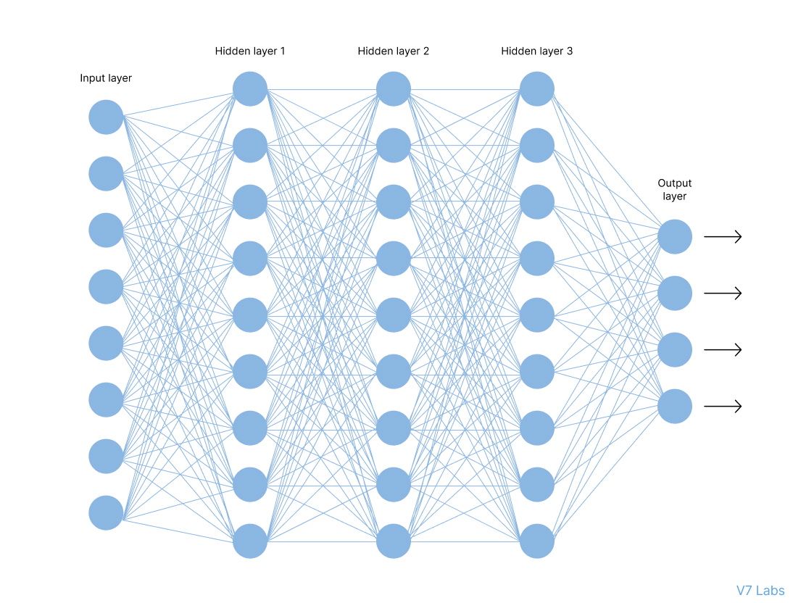
Artificial Neural Networks (ANN)
"...a computing system made up of a number of simple, highly interconnected processing elements, which process information by their dynamic state response to external inputs.“ -- the inventor of one of the first neurocomputers, Dr. Robert Hecht-Nielsen

Slide 21
Elements of a Neural Networks Architecture
A neural network made of interconnected neurons. Each of them is characterized by its weight (W), bias (b), and activation function (f). Neurons are arranged in:
Input Layer: The input layer takes raw input from the domain. No computation is performed at this layer. Nodes here just pass on the information (features) to the hidden layer.
Hidden Layer: The hidden layer performs all kinds of computation on the features entered through the input layer and transfers the result to the output layer.
Output Layer: It brings the information learned through the hidden layer and delivers the final value as a result.

Slide 22
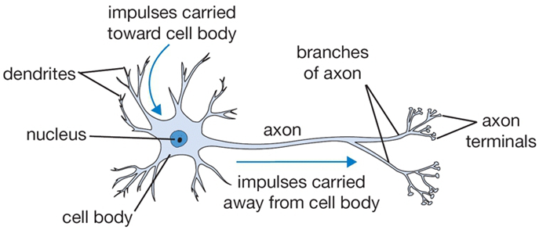
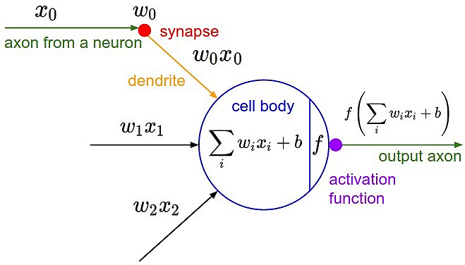
ANN: Neurons
Neuron:
The basic unit of computation in a neural network is the neuron , often called a node or unit. It receives input from some other nodes, or from an external source and computes an output.
Each input has an associated weight (w), which is assigned on the basis of its relative importance to other inputs.
The node applies a function to the weighted sum of its inputs.
b is a bias,

Slide 23
ANN: Activation function
Activation function: f
The idea is that the weights (w) are learnable (changeable)
It control the strength of influence and direction: excitory (positive weight) or inhibitory (negative weight) of one neuron on another.
All the signals are summed. If the final sum is above a certain threshold, the neuron can fire, sending a spike along its axon.

Slide 24
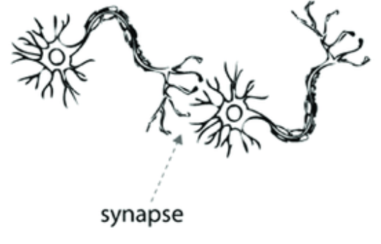
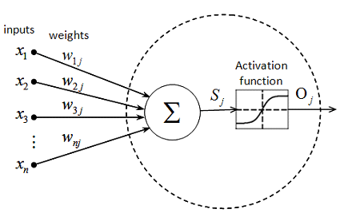
Active function
biologically the neurons are connected through synapses where information flows (weights for out computational model), when we train a neural network we want the neurons to fire whenever they learn specific patterns from the data, and we model the fire rate using an activation function.

Slide 25
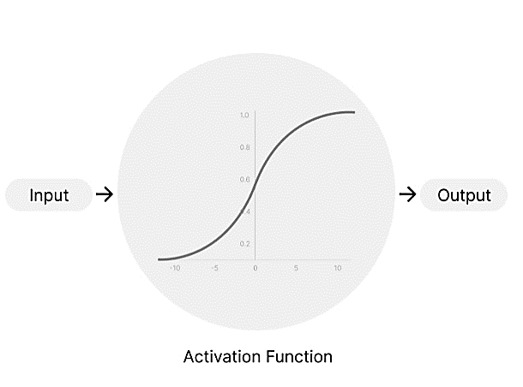
Why do NN need an Activation Function?
the purpose of an activation function is to add non-linearity to the neural network.

Slide 26
Types of activation functions
(ReLu function)

Slide 27
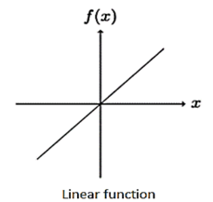
Linear Activation Function
The linear activation function, also known as "no activation," or "identity function" (multiplied x 1.0), is where the activation is proportional to the input. It simply spits out the value it was given.

Slide 28
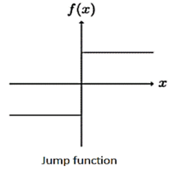
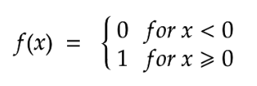
Binary Step Function
Binary step function (jump function) depends on a threshold value that decides whether a neuron should be activated or not. The input fed to the activation function is compared to a certain threshold; if the input is greater than it, then the neuron is activated, else it is deactivated, meaning that its output is not passed on to the next hidden layer.

Slide 29
Linear and Non-linear functions
The linear activation function is simply a linear regression model. It does not allow the model to create complex mappings between the network’s inputs and outputs.
Non-linear activation functions solve the limitations of linear.
They allow backpropagation because now the derivative function would be related to the input, and it’s possible to go back and understand which weights in the input neurons can provide a better prediction.
They allow the stacking of multiple layers of neurons as the output would now be a non-linear combination of input passed through multiple layers. Any output can be represented as a functional computation in a neural network.

Slide 30
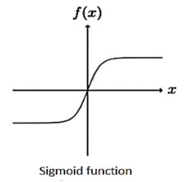
Sigmoid/Logistic Activation Function
This function takes any real value as input and outputs values in the range of -1 to -1 (0 to 1). The larger the input (more positive), the closer the output value will be to 1.0, whereas the smaller the input (more negative), the closer the output will be to -1 (or 0.0), as shown below.

Slide 31
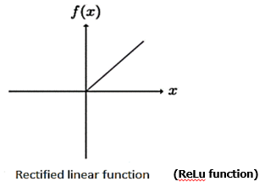
ReLU Function
ReLU stands for Rectified Linear Unit. The main catch here is that the ReLU function does not activate all the neurons at the same time. The neurons will only be deactivated if the output of the linear transformation is less than 0.

Slide 32
Softmax Function*
Softmax activation function, is also called softargmax or normalized exponential function,
it converts a vector of K real numbers into a probability distribution of K possible outcomes (the sum will be 1).
It is a generalization of the logistic function and is often used as the last activation function of a neural network to normalize the output of a network to a probability distribution
[1.8, 0.9, 0.68]=>[0.58, 0.23, 0.19]

Slide 33
Six basic types of Artificial Neural Networks
https://lionbridge.ai/articles/6-types-of-neural-networks-every-data-scientist-must-know/
Perceptron
Multi-layer perceptron (MLP)
Convolutional neural network (CNN)
Recurrent neural network (RNN)
Long short-term memory (LSTM)
Generative Adversarial Networks (GNN)
Hybrid
Encoder–decoder networks
competitive networks such as generative adversarial networks （GNN）

Slide 34
1. Perception
A single-layer neural networks. It is used as binary classifiers.
Input values are multiplied with their weights, then adds these values to create the weighted sum. Further, this weighted sum is applied to the activation function ‘f’ to obtain the desired output.

Slide 35
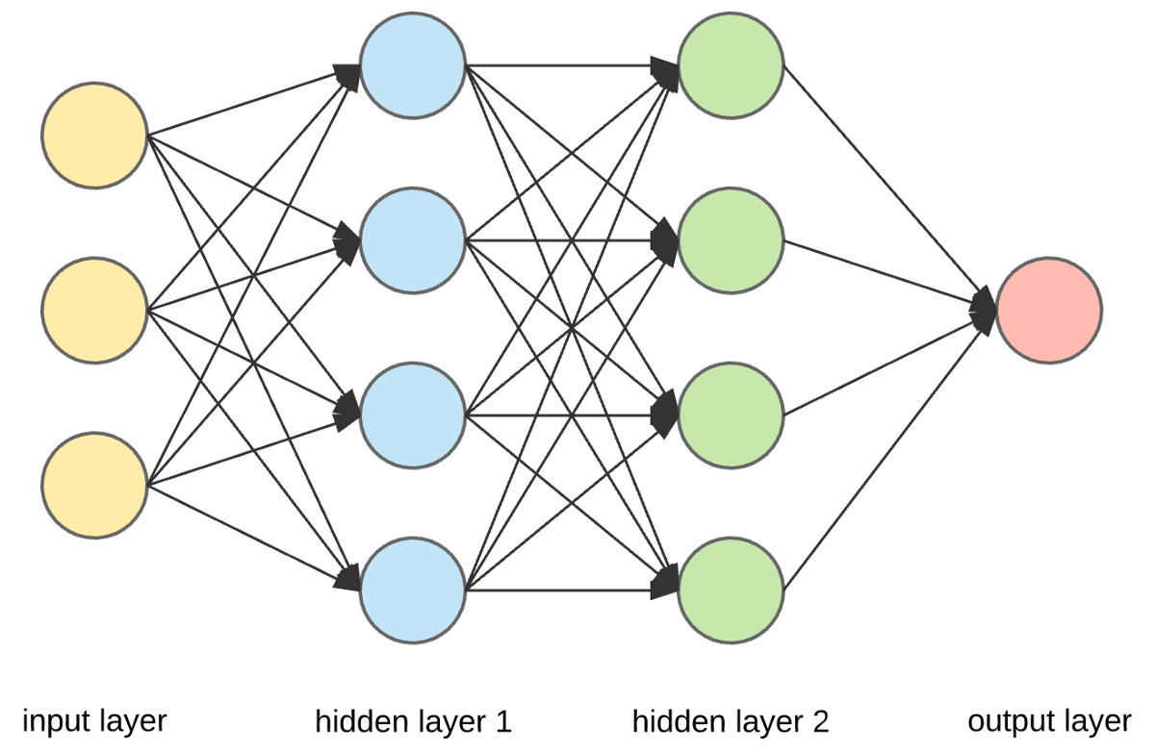
2. Multi-layer perception
A forward neural networks with multiple hidden layers. It has a greater processing power and can process linear and non-linear patterns. It is widely used many applications such as patten recognition, predictions.

Slide 36
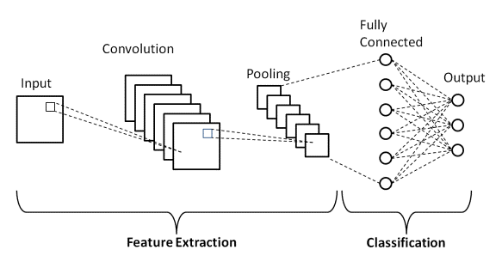
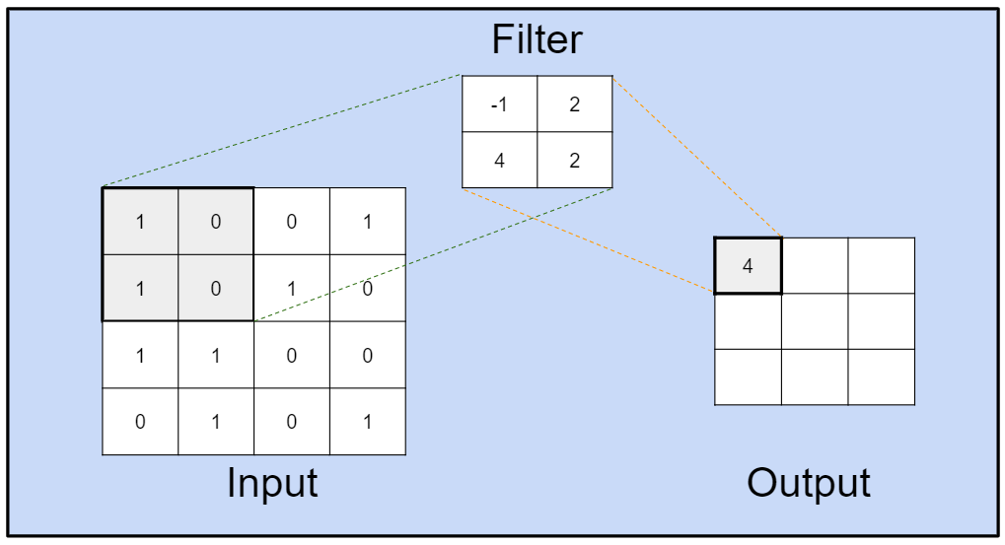
3. Convolutional Neural Networks (CNN)
CNN widely used for computer vision.
It has filter for input and a convolution layer that performs component-wise dot product.

Slide 37
4. Recurrent Neural Networks
RNN are networks designed to interpret temporal or sequential information. It takes input from the previous stage and gives its output as input to the next stage.
RNNs taking in input and reusing the activations of previous nodes or later nodes in the sequence to influence the output.

Slide 38
5. Long Short-Term Memory Networks
LSTM are a special case of RNNs which can not only retain the most recent information but also a longer retention.
LSTMs are widely used in language translation, speech recognition, text summarization, and video classification.

Slide 39
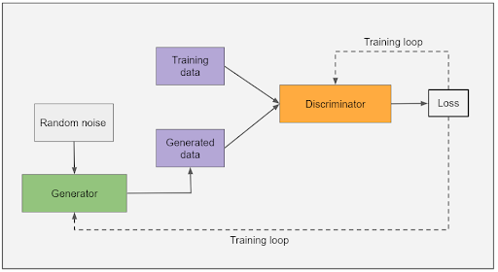
6. Generative Adversarial Networks
GNN contains a generator and a discriminator. The generator model creates new data while the discriminator tries to determine real data from generated data.
GANs are commonly used to create cartoon images or faces for gaming and animated movies..

Slide 41
ANN used in Information systems
Multilayer perceptron (MLP) is used natural language processing (NLP) applications such as speech recognition and machine translation.
CNN used in Sentence Classification , Text understanding, Semantic Parsing, Semantic parsing [3], paraphrase detection [4], speech recognition [5]
RNN used in Natural Language Generation, Paraphrasing and Summarization of User Reviews , Text Classification.
LSTM used in speech tagging, Named Entity Recognition, Text classification

Slide 42
Deep Neural Networks (DNN)

Slide 43
ImageNet challenge on Computer Vision
ImageNet challenge (2009) - ImageNet Large Scale Visual Recognition Challenge (ILSVRC)

Slide 44
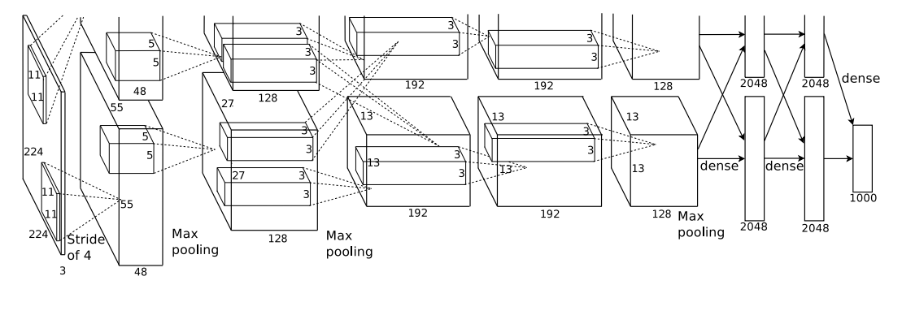
Deep Neural Networks
https://proceedings.neurips.cc/paper/2012/file/c399862d3b9d6b76c8436e924a68c45b-Paper.pdf
The networks contains eight layers with weights; the first five are convolutional and the remaining three are fully connected.

Slide 45
Deep Neural Networks
The network’s input is 150,528-dimensional, and the number of neurons in the network’s remaining layers is given by 253,440–186,624–64,896–64,896–43,264– 4096–4096–1000.
The figure also explicitly showing the delineation of responsibilities between the two GPUs. One GPU runs the layer-parts at the top of the figure while the other runs the layer-parts at the bottom. The GPUs communicate only at certain layers.
-- Transfer learning

Slide 46
Impact of DNN
The success of ImageNet highlighted the arrival of the era of deep learning
Among the three cornerstones of the NN: Data, Algorithm and the Architecture, architecture overtakes the other two in terms of importance
Allowed a breakthrough transfer learning: the weights learned in state of the art models for ImageNet could be used to initialize models for completely other datasets and improve performance significantly.
This "fine-tuning" approach allowed achieving good performance with as little as one positive example per category (Donahue et al., 2014)

Slide 47
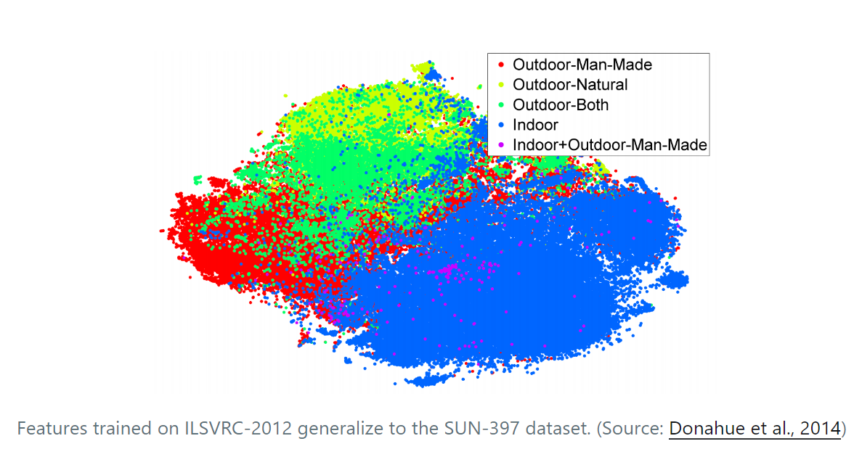
Pretrained model and transfer learning
Pretrained ImageNet models have been used to achieve state-of-the-art results in almost all tasks

Slide 48
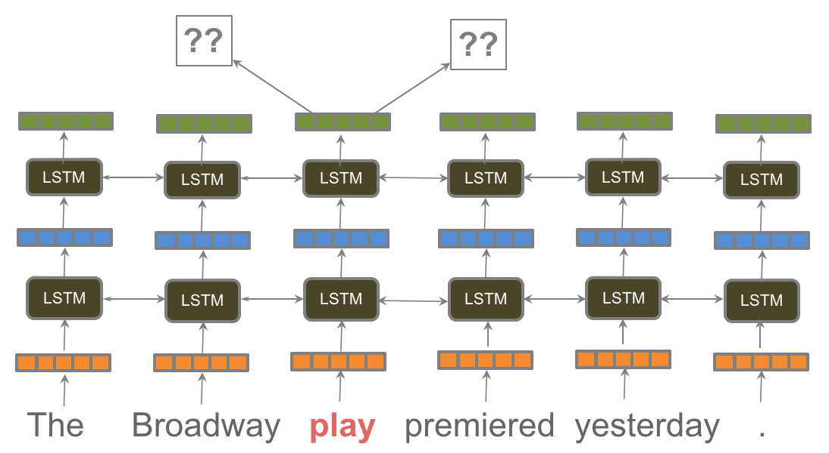
“An ImageNet for language”
ELMo, ULMFiT, and the OpenAI transformer. These works made headlines by demonstrating that pretrained language models can be used to achieve state-of-the-art results on a wide range of NLP tasks. Such methods herald a watershed moment: they may have the same wide-ranging impact on NLP as pretrained ImageNet models had on computer vision.
-- SEBASTIAN RUDER 12 JUL 2018
https://ruder.io/nlp-imagenet/

Slide 49
DNN in Information Systems
The biggest problem in Information system is Natural Language Understanding (NLU)
Computational Linguistics uses many machine learning techniques include naïve Bayes, k-nearest neighbours, hidden Markov models, decision trees, random forests, and support vector machines since 1080s.
The use of neutral networks for NLP did not start until the early 2000s. But by the end of 2010s, neural networks transformed NLP, enhancing or even replacing earlier techniques. [https://arxiv.org/pdf/1807.10854.pdf]
This has been made possible because we now have more data to train neural network models and more powerful computing systems to do so.

Slide 50
DNN used in NLP
Datasets:
Stanford Question Answering Dataset (SQuAD)
Stanford Natural Language Inference (SNLI) Corpus
WikiText-2 dataset
Language modelling: using pretrained models (transfer learning) + fine-tune proved to be more success and also in many downstream tasks:
long-term dependencies
hierarchical relations
sentiment.

Slide 51
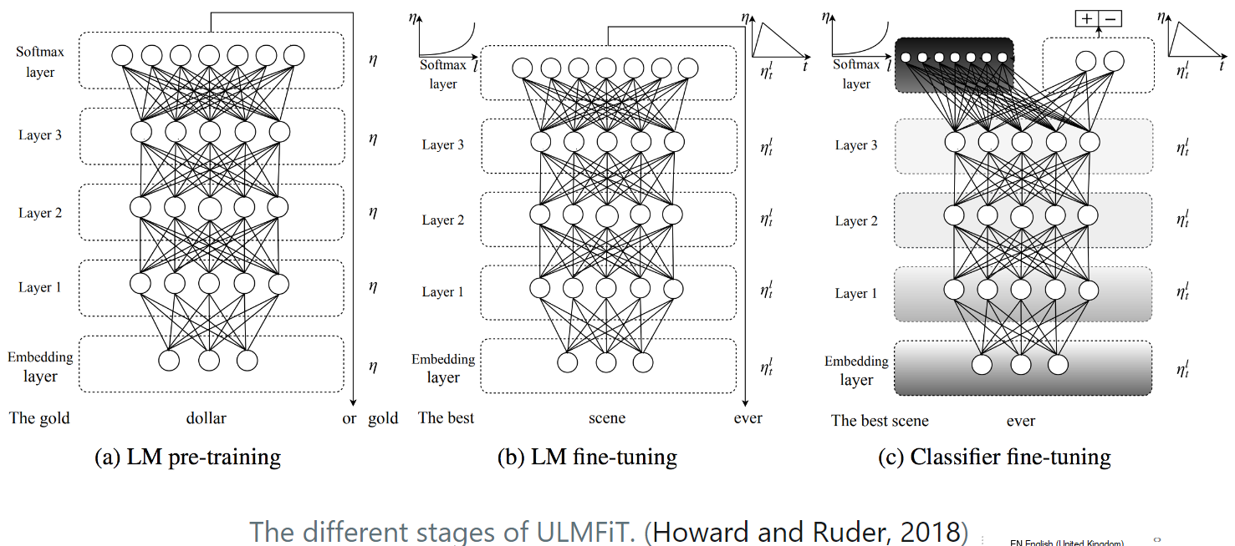
Pretrained NN examples
Embeddings from Language Models (ELMo)
Universal Language Model Fine-tuning (ULMFiT)
OpenAI Transformer

Slide 52
The latest NN application in NLP
BERT: Bidirectional Encoder Representations from Transformers (BERT)
BLOOM: BigScience Large Open-science Open-access Multilingual Language Model with 176 billion parameters.
GPT-2: Generative Pre-trained Transformer 2 with 1.5 billion parameters.
GPT-3: Generative Pre-trained Transformer 3, with the unprecedented size of 2048-token-long context and 175 billion parameters (requiring 800 GB of storage).

Slide 53
GPT3
https://www.youtube.com/watch?v=PqbB07n_uQ4&t=388s

Slide 54
Example of using GPT3
Build a chat box with GPT3
https://www.youtube.com/watch?v=74WPFGAADt4
Open AI Playground: https://beta.openai.com/playground

Slide 55
Summary
AI is a hot, debatable area particularly on the aspect of what is intelligence.
AI has achieved a great advancements (computer vision and NLP) thanks to distributed computing and Big Data.
AI in its 3rd wave and driven by advancement in ANN and Machine Learning
ANN is trying to build a biological brain on computer (with memory and computation similar to human)
ANN has three cornerstones: Architecture, Algorithms and training data. The focuse was algorithm -> architecture (connection and depth of the layers) -> data
ANN have great potential in NLP (part of human intelligence)

